Slide 1
Transaction Set
By Usman Waheed
Date of transaction : 25 October 2012

Slide 2
Agenda
Transaction
Transaction Pattern
Analysis and design Challenges
Players of transaction pattern
Transaction Sets in transaction Pattern
Attributes and behaviors of transaction pattern
New attributes and behaviors
How to develop analysis model with the help of transaction pattern
Workflow management with the help of transaction pattern

Slide 3
Transaction
A transaction is a recording or logging of any event of significance; hence, transaction is
“a significant event remembered”
Transaction usually involve
Currency
Date and time
Count
Notes:
http://faculty.cs.tamu.edu/lively/cpsc606/606html/start.htm
http://faculty.cs.tamu.edu/lively/cpsc606/606html/coa00059.htm

Slide 4
Analysis and design Challenges
Completeness
Correctness
Coverage
In-term of entities, fields, relationship
And after design
In-term of values, and reports

Slide 5
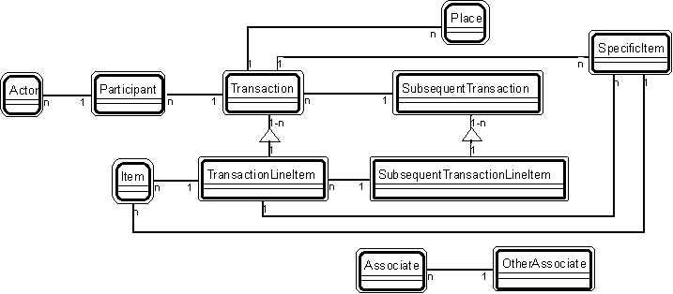
Transaction Pattern

Slide 7
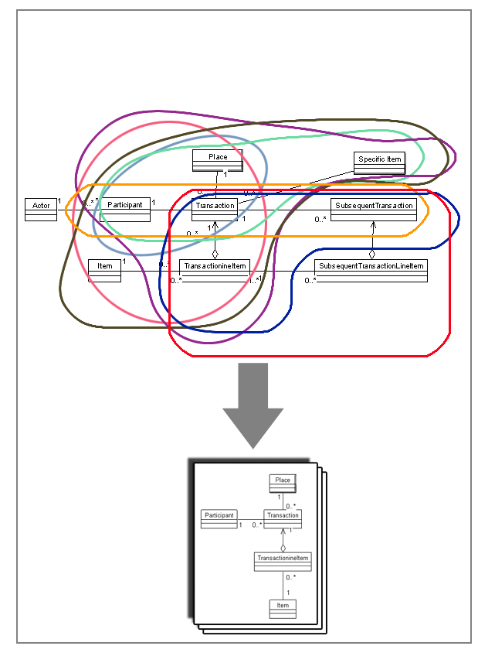
Transaction sets of transaction pattern
Transaction based on participant
Transaction based on items
Transaction based on subsequent transaction

Slide 8
1-Transaction based on participant
Examples:
Patient - appointment - clinic
Student - attendance
Visitor - gate pass – department
Driver – driving license

Slide 9
2-Transaction Based on Items
General item transaction
Examples:
Customer- order –order line item –product- Metro-2
Buyer –payment –payment line item -goods
Vendor – purchase- purchase line item - products
Sr.no | Description | Qty | Price
1 | Pen | 1 | 150
2 | Pencil | 12 | 120
3 | Eraser | 5 | 50
 |  | Total

Slide 10
2-Transaction Based on Items
Specific item transaction
These transactions are based on items whose individual identity is important to track such as the serial number.
Examples:
Investor- payment- Specific aircraft
Agent – loading - specific container - port
Shipper - shipment - specific ship,
Buyer – rental- specific vehicle
Member – subscribe –specific credit card
Sr.no | Description | Unique Sr. no | Price
1 | Laptop hp1 | 1234…89 | 600
2 | Laptop hp2 | 1234…90 | 600
3 | Laptop hp3 | 1234…91 | 600
 |  | Total

Slide 11
2-Transaction Based on Items
Specific item transaction with line item
These transactions support multiple specific items.
Examples:
Student – issue –issue line item –specific book
Customer –purchase –purchase line item – electric goods
Account holder – deposit –deposit line item – cash bonds - bank branch
Buyer – purchase –purchase line item – computer accessories
Sr.no | Description | Unique Sr. no | Price
1 | Laptop hp | 1234…89-99 | 60000
2 | Laptop dell | 1435…90-100 | 60000
3 | Portable HD Dell | 1234…91-95 | 6000
 |  | Total

Slide 12
2-Transaction Based on Items
General and specific item transaction
These transactions are based on both kind of items, general items and specific items.
Examples:
Customer –purchase –purchase line item – electric goods - goods
Buyer – purchase –purchase line item – computer accessories – printer pages -department
Customer- order – order line item – product – specific product
Sr no | Description | Unique Sr. no | Qty | Price
 | Pen- hero |  | 2 | 100
 | Laptop –dell | GM34354672-18 | 1 | 90000
 | Charger |  | 3 | 500
 | Iron –Brown-Y-43567 |  | 1 | 4500

Slide 13
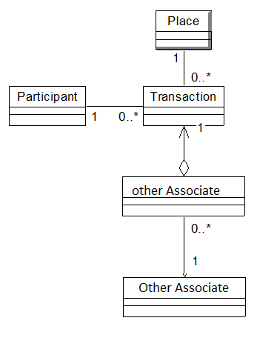
2-Transaction Based on non-Items (service)
Non item transaction
Examples:
Student- registration- registered courses- Courses
Trainee- pay fee- fee detail – fee heads
Customer- Maintenance – maintenance detail - parts
Sr.no | Description | Price
1 | Scaling | 3000
2 | Rootcanal r12 | 8000
3 | Cap l8 | 12000

Slide 14
3- Transaction based on subsequent transaction.
Transaction and subsequent transaction both without line item
These types of transactions involve simple transaction and subsequent transaction.
Examples:
Patient – appointment – treatment /admission
Student - attendance – examination
Visitor - gate pass – entry

Slide 15
3- Transaction based on subsequent transaction.
Transaction with line item and subsequent transaction without line item
These types of transactions involve transaction with line item and subsequent transaction without line item.
Examples:
Order –order line item -payment
Purchase- purchase line item - packing

Slide 16
3- Transaction based on subsequent transaction.
Transaction and subsequent transaction both with line item
These types of transactions involve transaction and subsequent transaction both with line item.
Examples:
Order –order line item –payment – payment line item
Payment –payment line item –shipment-shipment line item
Purchase- purchase line item – packing –packing line item

Slide 17
Attributes and behaviors of transaction pattern

Slide 18
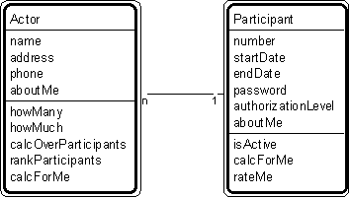
Patterns For Building Object Models Patt#2. "Actor-Participant" Pattern // transaction patterns

Slide 19
Examples
Actor: people and organizations that act as participants within the system under consideration
Examples
- Actor: person, organization (agency, company, corporation, foundation)
- Participant: agent, applicant, buyer, cashier, clerk, client, civilian, customer, dealer, delegate, distributor, donor, employee, investor, manufacturer, member, officer, official, order clerk, owner, participant, policy holder, professional, prospect, recipient, retailer, sales clerk, sales rep, shipper, student, subscriber, supervisor, supplier, suspect, teacher, wholesaler, worker, vendor
- Additional examples: anything used for different missions, such as aircraft-civilian mission, aircraft-military mission.

Slide 20
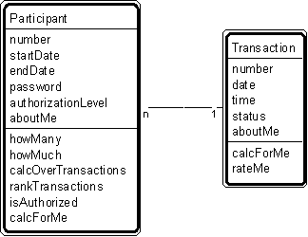
. Patt#3 "Participant-Transaction" Pattern // transaction patterns

Slide 21
Examples
Transactions: "events remembered," events that the system must remember through time. A transaction is a moment in time (for example, a sale) or an interval of time (for example, a rental).
- Participant: agent, applicant, buyer, cashier, clerk, client, civilian, customer, dealer, delegate, distributor, donor, employee, investor, manufacturer, member, officer, official, order clerk, owner, participant, policy holder, professional, prospect, recipient, retailer, sales clerk, sales rep, shipper, student, subscriber, supervisor, supplier, suspect, teacher, wholesaler, worker.
- Transaction: agreement, assignment, authorization, contract, delivery, deposit, incident, inquiry, order, payment, problem, report, purchase, refund, registration, rental, reservation, sale, shift, shipment, subscription, time charge, title, withdrawal.

Slide 22
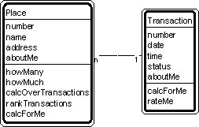
Patt#4 "Place-Transaction" Pattern // transaction patterns

Slide 23
Examples
Places : where things come to rest, places that contain other objects-
Examples:
Place: airport, airport, bank, clinic, depot, garage, geographic entity, hangar, hospital, manufacturing site, plant, region, sales outlet, service center, shelf, station, store, warehouse, zone.
- Transaction: agreement, assignment, authorization, contract, delivery, deposit, incident, inquiry, order, payment, problem, report, purchase, refund, registration, rental, reservation, sale, shift, shipment, subscription, time charge, title, withdrawal.

Slide 24
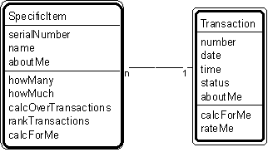
Patt#5. "Specific Item - Transaction" Pattern // transaction patterns

Slide 25
Examples
- Specific item: specific aircraft, specific container, specific ship, specific register, specific vehicle, specific device.
- Transaction: agreement, assignment, authorization, contract, delivery, deposit, incident, inquiry, order, payment, problem, report, purchase, refund, registration, rental, reservation, sale, shift, shipment, subscription, time charge, title, withdrawal.

Slide 26
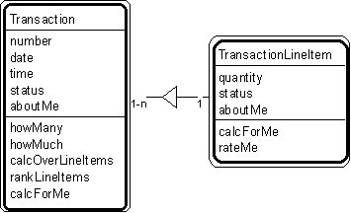
Patt#6. "Transaction - Transaction Line Item" Pattern // transaction patterns

Slide 27
Examples
- Transaction: agreement, assignment, authorization, contract, delivery, deposit, incident, inquiry, order, payment, problem, report, purchase, refund, registration, rental, reservation, sale, shift, shipment, subscription, time charge, title, withdrawal.
- Transaction - transaction line item: deposit - deposit line item; order - order line item; payment - payment line item; rental - rental line item; sale - sale line item; shipment - shipment line item; withdrawal - withdrawal line item.

Slide 28
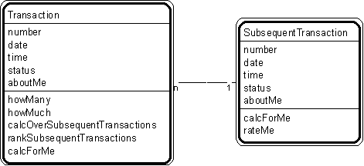
Patt#7. "Transaction - Subsequent Transaction" Pattern // transaction patterns

Slide 29
Examples
- Transaction: agreement, assignment, authorization, contract, delivery, deposit, incident, inquiry, order, payment, problem, report, purchase, refund, registration, rental, reservation, sale, shift, shipment, subscription, time charge, title, withdrawal.
- Transaction - subsequent transaction: application-issue; intermediate result - final result; order-shipment; purchase-payment; reservation-sale; traffic citation - payment.

Slide 30
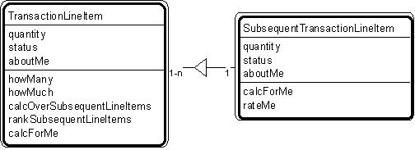
Patt#8. "Transaction Line Item - Subsequent Transaction Line Item" Pattern // transaction patterns

Slide 31
Examples
Transaction line items: agreement, assignment, authorization, contract, delivery, deposit, incident, inquiry, order, payment, problem report, purchase, refund, registration, rental, reservation, sale, shift, shipment, subscription, time charge, title, withdrawal.
Transaction line item - subsequent transaction line item: order line item - shipment line item; reservation line item - rental line item; shipment line item - delivery line item.

Slide 32
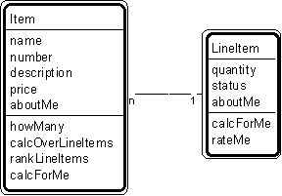
Patt#9. "Item - Line Item" Pattern // transaction patterns

Slide 33
Examples
- (with transaction line items) item - order line item; item - payment line item; item - rental line item; item - sale line item; item - shipment line item (with container line items) item - bin line item; item - warehouse line item.

Slide 34
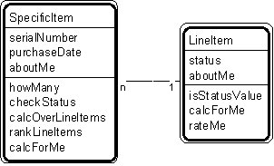
Patt#10. "Specific Item - Line Item" Pattern // transaction patterns

Slide 35
Examples
- specific aircraft - line item; specific vehicle - line item; videotape - rental line item.

Slide 36
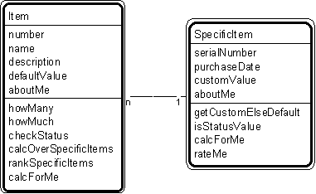
Patt#11. "Item - Specific Item" Pattern // transaction patterns

Slide 37
Examples
- aircraft - specific aircraft; loan description - specific loan; job description - specific job; video description - videotape; price category - item - specific item (pattern, applied twice); tax category - item - specific item (pattern, applied twice).

Slide 38
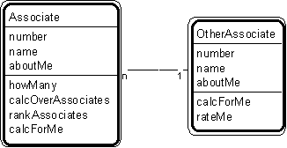
Patt#12. "Associate - Other Associate" Pattern // transaction patterns

Slide 39
Examples
Associates: objects that need to know each other, but they are not defined by transaction pattern.
- aileron-gyro; aircraft-runway; building-sensor; driver-vehicle; loading dock - order; order-tote; truck - loading dock.
Participant: its education, contact information, hobbies, likes and dislikes
Transaction: its type, characteristic, movement, possible actions
Item: its category, identification, feature, Suppliers and manufacturers , Inventory item storage, costing

Slide 40
New attributes
Players | Attributes
Actor | Name, address, phone
Participant | Number, start date, end date, authorization level, password, Picture , e-link, NTN ,CNIC, Status
Transaction | Number, date, time, status, T-Date , E-Date
Transaction line item | Number, quantity, status, Date
Item | Number, name , description, price, default value , Picture, digital id
Specific item | Serial number, purchase date, custom value,
Place | Number, name, address, direction, map-id
Other Associate | Number, name , description,

Slide 41
How to develop analysis model with the help of transaction pattern
Study and Analyze the transaction
Select appropriate Transaction Set
Map real objects to TP Players
Add standard attributes
Add further attributes in place of aboutMe
Add standard behaviors
Associate one transaction to another
Add behaviors with respect to associated transaction(s)

Slide 42
Workflow management with the help of transaction pattern
You can connect any transaction with other, just by adding (Associative entity) between them (M-M)

